Slide 1
18ECO127T 5G Technology – An Overview
OPEN ELECTIVE (by ECE)
B.TECH
M1 S0

Slide 2
MODULE 1: Introduction to Wireless Communication Fundamentals and 5G Technology
Introduction to 5G Technology: Evolution of Cellular Networks: From 1G to 5G
Key Features and Objectives of 5G
5G Use Cases and Applications
5G Use Cases and Applications
Challenges and Opportunities in 5G Deployment
Wireless Communication Fundamentals: Overview of Wireless Communication Systems;
Frequency Bands and Spectrum Allocation in 5G;
Multiple Access Techniques: FDMA, TDMA, CDMA
Modulation Techniques: QPSK, QAM, OFDM

Slide 3
MODULE 1: Introduction to Wireless Communication Fundamentals and 5G Technology
M1 S0
5G Introduction As per INDIAN perspective where we are today?

Slide 4
Overview of the Subject (Five Modules)
Module-1: Introduction to Wireless Communication Fundamentals and 5G Technology
Modele-2: 5G Network Architecture
Module-3: Radio Access Technologies in 5G
Module-4: 5G Security and Privacy
Module-5: 5G and Internet of Things (IoT)

Slide 5
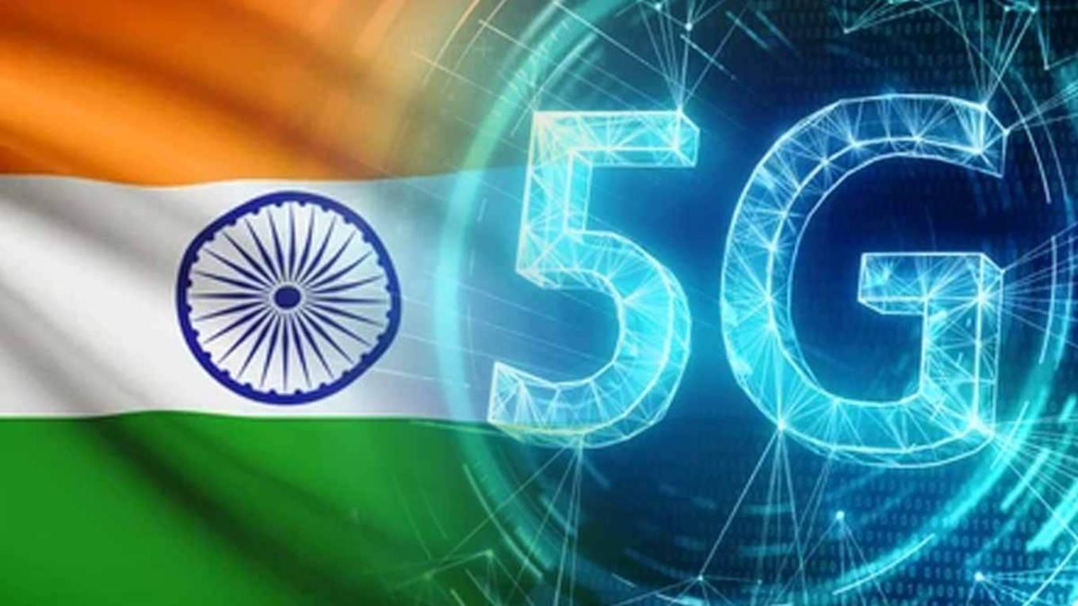
5G Introduction
As per INDIAN
perspective where we are today?

Slide 6
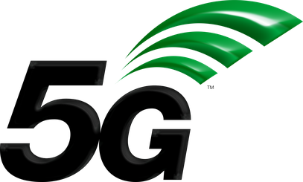
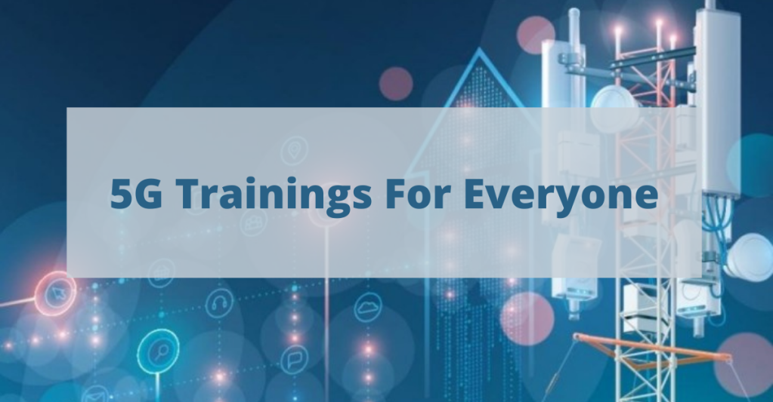
Why 5G in Academic?
Thematic flow of 5G into Academic:
Event:
5G services were launched in India during October 2022
5G is being expanded on war footing throughout the nation
Future Scenario:
Expected customers of 5G market;
Various Industries
Military force
Ordinary telephone/internet users
Future 5G market needs 5G experts in large numbers for;
Research & Development in 5G
Service to 5G customers
Action:
Students need to be skilled to grab this Golden Opportunity in 5G arena
Notes:
Source: https://dot.gov.in/5g-india-2020

Slide 7
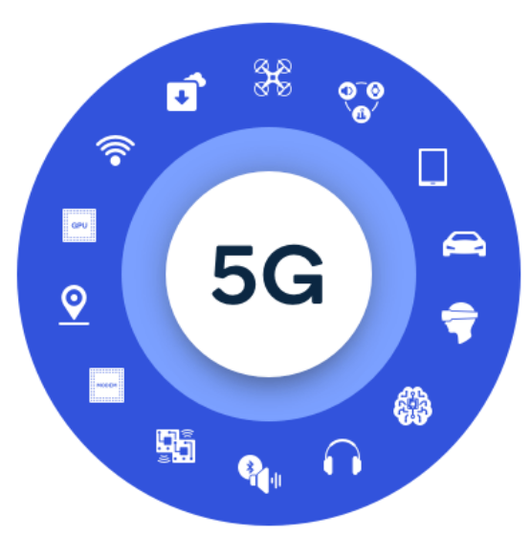
Overview of 5G Technology
Introduction:
5G: 5th Generation mobile network
5G is a new global wireless standard after 1G, 2G, 3G, and 4G networks
5G was commercialized in 2019
No company or person invented or owns 5G
There are several companies within the mobile ecosystem that are contributing to bringing 5G to life Challenges
3rd Generation Partnership Project (3GPP), the industry organization that defines the global specifications for 3G UMTS (including HSPA), 4G LTE, and 5G technologies
Notes:
Source: https://www.qualcomm.com/

Slide 8
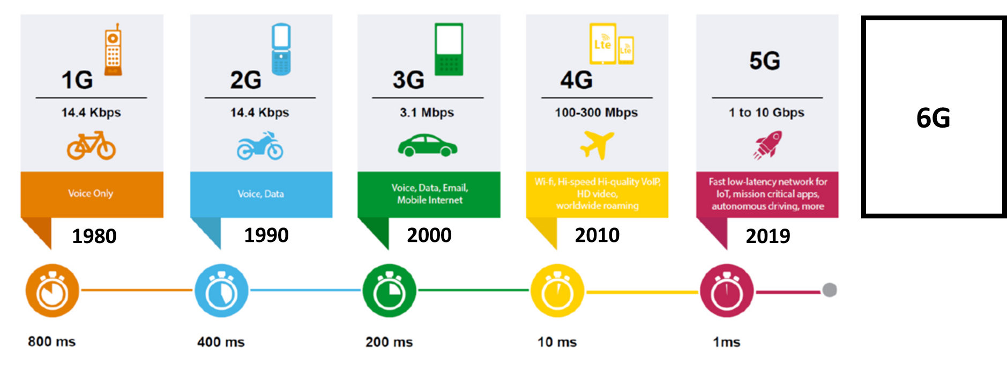
Overview of 5G Technology
Evolution of 5G:
Notes:
Source: https://www.qualcomm.com/

Slide 9
What make up 5G?
3 Key Points:
Technology:
Based on OFDM (Orthogonal Frequency Division Multiplexing)
It also uses wider bandwidth technologies such as sub-6 GHz and mmWave
Frequency Specifications:
Can operate in both lower bands (e.g., sub-6 GHz) as well as mmWave (e.g., 24 GHz and up)
In India now: sub-6 GHz
This will bring extreme capacity, multi-Gbps throughput, and low latency
Operation:
Not only faster and better than 4G, but can be expanded to mission-critical communications and connecting the massive IoT
Notes:
Source: https://www.qualcomm.com/

Slide 10
How 5G is better than 4G?
5G is a Unified Platform that is more capable than 4G
Not only for Broadband Telephone but also for mission-critical communications and connecting the massive IoT
Supports all Spectrum types (licensed, shared, unlicensed) and bands (low, mid, high)
5G uses Spectrum Better than 4G
Can use in bands - from low bands below 1 GHz, to mid bands from 1 GHz to 6 GHz, to high bands known as millimeter wave (mmWave).
5G is Faster than 4G:
Delivers up to 20 Gigabits-per-second (Gbps) peak data rates and 100+ Megabits-per-second (Mbps) average data rates
5G has More Capacity than 4G
Support a 100x increase in traffic capacity and network efficiency
5G has Lower Latency than 4G
10x decrease in end-to-end latency
Notes:
Source: https://www.qualcomm.com/

Slide 11
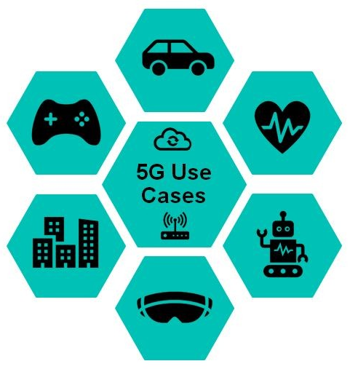
Potential Applications of 5G
Autonomous
Vehicles
Video Game
Live Streaming
Remote
Health Monitoring
Smart Buildings
And Cities
Industry Connection
And Automation
Augmented and
Virtual Reality
Notes:
Source: https://www.qualcomm.com/

Slide 12
Challenges in 5G
Key Challenges:
Frequency Bands:
5G NR: for sub-6 GHz and millimeter-wave range
Design of hardware at millimeter waves are much complex than low frequency range
To support interoperability -> Needs multiband -> Addition of more band increases complexity
High Data Volume:
To support high resolution video calling, live streaming, downloading -> huge volume data support is required
MIMO Technology:
For High data speed -> MIMO/massive MIMO is need -> Algorithms becomes complex
Notes:
Source: https://www.rfpage.com/what-are-the-challenges-in-5g-technology/

Slide 13
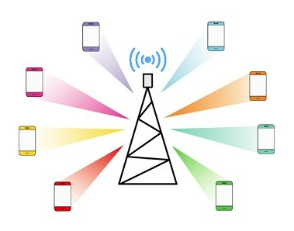
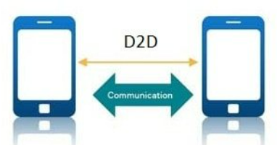
Challenges in 5G
Key Challenges:
Beamforming:
Complex task to locate each devices under a particular cell
Needs high level processing at base stations High Data Volume:
To support high resolution video calling, live streaming, downloading -> huge volume data support is required
D2D Communication:
Complex data transmission protocols required to implement this
Ultra Low Latency:
Latency less than 1 millisecond is required - else critical services to be affected
Security and Privacy:
Ensuring end-to-end security and privacy among multiples devices is challenging
Notes:
Source: https://www.rfpage.com/what-are-the-challenges-in-5g-technology/

Slide 14
5G in India
Status of 5G in India:
Officially launched in October 2022
Players: Reliance Jio and Airtel
As of November 2023: 5G launched in 738 Districts
December 2024: Target to achieve 100% 5G coverage
Jio -> 5G standalone (SA) network, Airtel -> 5G non-standalone (NSA) network
Notes:
Source: https://telecom.economictimes.indiatimes.com/news/india-will-achieve-100-5g-coverage-by-december-2024-vaishnaw/98297731

Slide 15
Kindly share your aspirations on subject

Slide 16
!!THANK YOU!! !! Have a Nice Day!!
Today we learned about
5G Introduction As per INDIAN perspective where we are today?

Slide 17
MODULE 1: Introduction to Wireless Communication Fundamentals and 5G Technology
Introduction to 5G Technology: Evolution of Cellular Networks: From 1G to 5G
Key Features and Objectives of 5G
5G Use Cases and Applications
5G Use Cases and Applications
Challenges and Opportunities in 5G Deployment
Wireless Communication Fundamentals: Overview of Wireless Communication Systems;
Frequency Bands and Spectrum Allocation in 5G;
Multiple Access Techniques: FDMA, TDMA, CDMA
Modulation Techniques: QPSK, QAM, OFDM

Slide 18
MODULE 1: Introduction to Wireless Communication Fundamentals and 5G Technology
M1 S1
Wireless Communication Fundamentals: Overview of Wireless Communication Systems

Slide 19
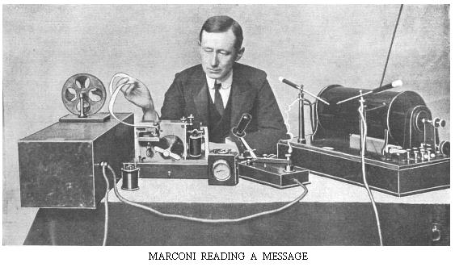
Wireless Communication Fundamentals: Overview of Wireless Communication Systems
Wireless communication, is a field that has been around for over a hundred years, starting around 1897 with Marconi’s successful demonstrations of wireless telegraphy.
By 1901, radio reception across the Atlantic Ocean had been established; thus rapid progress in technology has also been around for quite a while.
In the intervening hundred years, many types of wireless systems have flourished, and often later disappeared.
For example, television transmission, Now been replaced by DTH service, OTT services, Internet etc

Slide 20

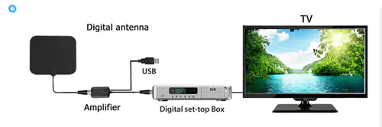
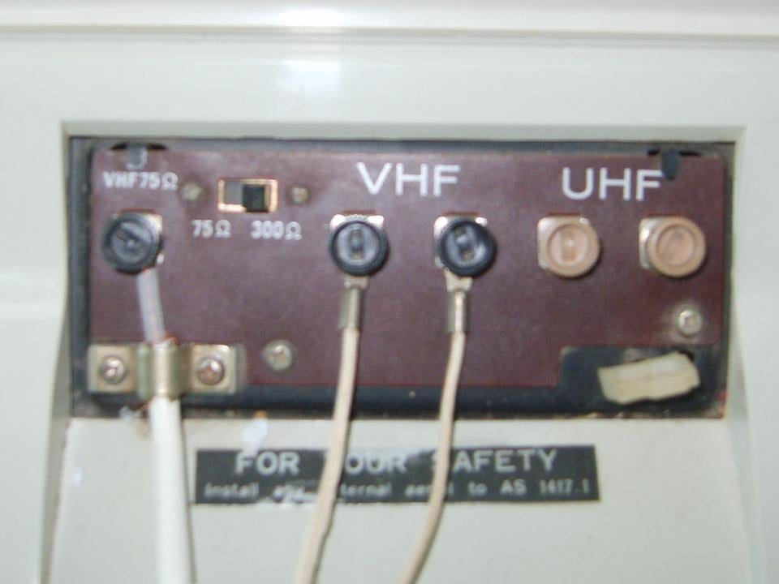
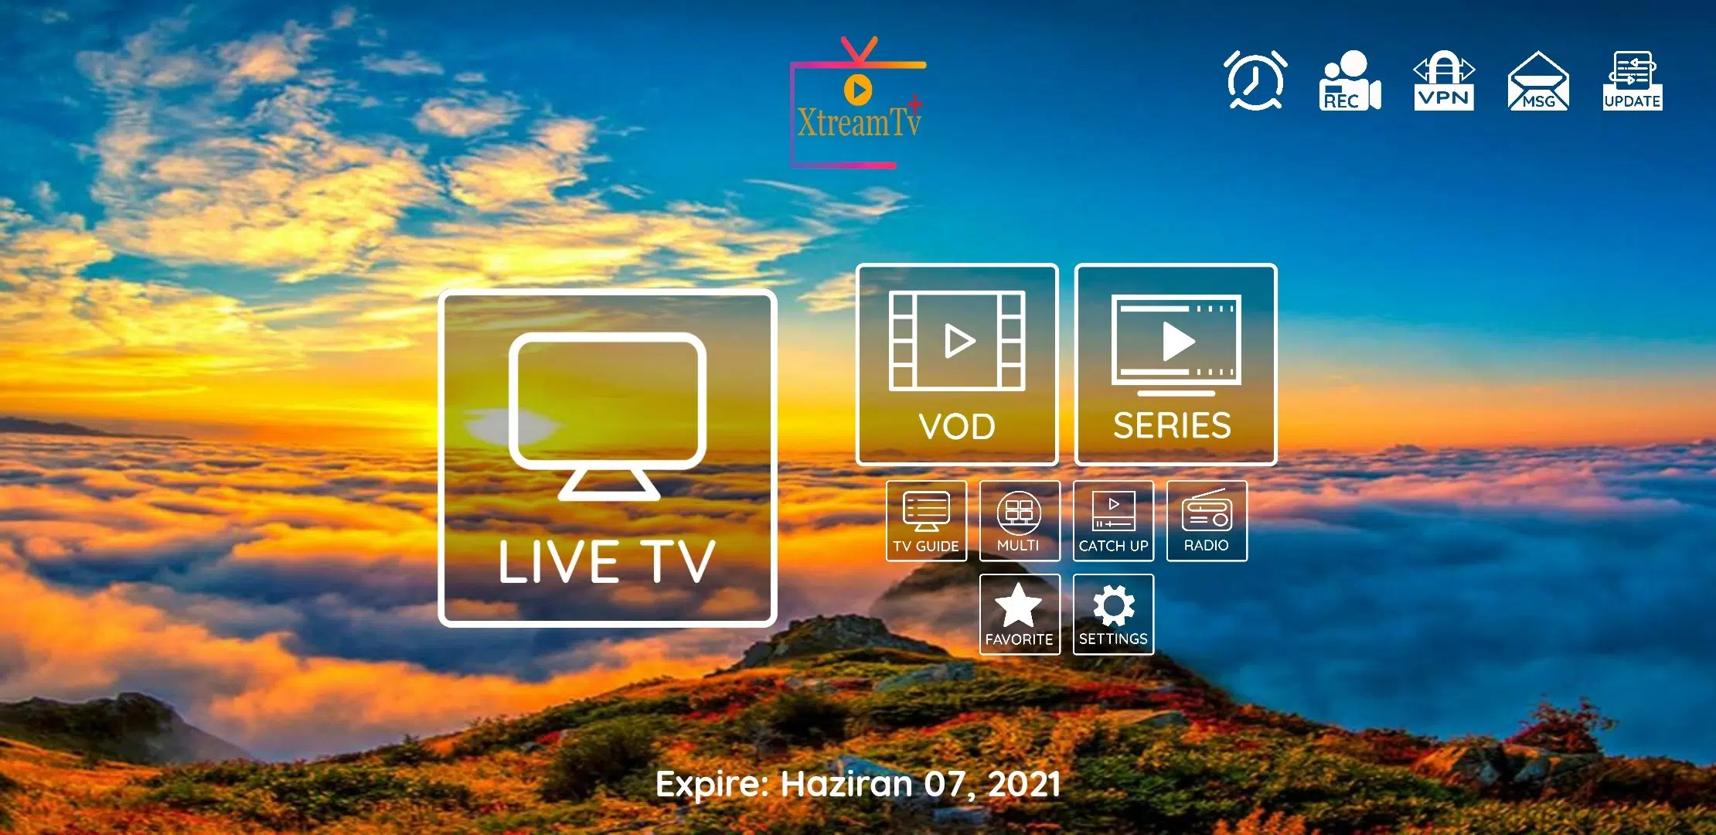
Wireless Communication Fundamentals: Overview of Wireless Communication Systems
In its early days, T.V. was broadcast by wireless radio transmitters, which is increasingly being replaced by cable transmission and then again replaced by DTH services and finally Now a days Fiber trend is going on.

Slide 21
Wireless Communication Fundamentals: Overview of Wireless Communication Systems
In the first, wireless technology (RF transmission) became outdated when a wired distribution network (UHV-CA-TV) was installed;
in the second, a CA-TV is been replaced by wireless Technology (DTH) Now Today DTH services is replaced by (optical fiber) Technology.

Slide 22
Wireless Communication Fundamentals: Overview of Wireless Communication Systems
The point of these examples is that there are many situations in which there is a choice between wireless and wire technologies, and the choice often changes when the new technologies become available.
Here in this course we will concentrate on cellular networks, both because they are of great current interest and also because the features of many other wireless systems can be easily understood as special cases or simple generalizations of the features of cellular networks.
A cellular network consists of a large number of wireless subscribers
who have cellular telephones (users), that can be used in cars, in buildings, on the street, or almost anywhere.

Slide 23
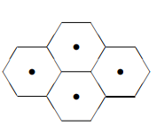
Wireless Communication Fundamentals: Overview of Wireless Communication Systems
There are also a number of fixed base stations, arranged to provide coverage of the subscribers.
The area covered by a base station, i.e., the area from which incoming calls reach that base station, is called a cell.
One often pictures a cell as a hexagonal region with the base station in the middle.
One then pictures a city or region as being broken up into a hexagonal lattice of cells

Slide 24
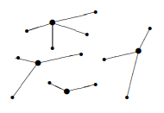
Wireless Communication Fundamentals: Overview of Wireless Communication Systems
In reality, the base stations are placed somewhat irregularly, depending on the location of places such as building tops or hill tops that have good communication coverage and that can be leased or bought
Similarly, mobile users connected to a base station are chosen by good communication paths rather than geographic distance.

Slide 25
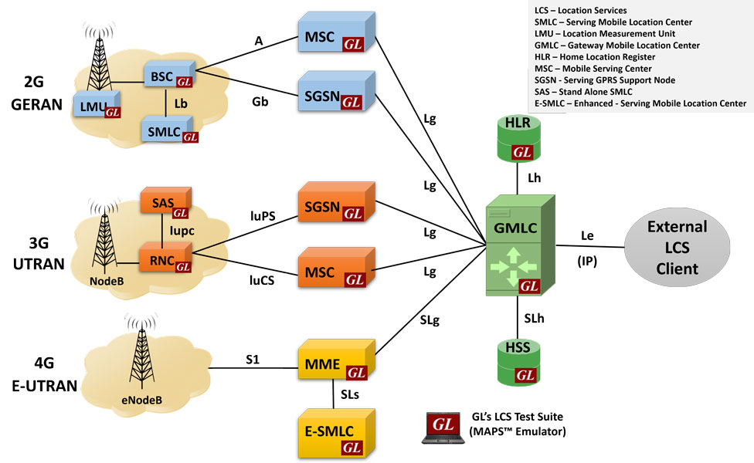
Call Example:

Slide 26
Call Example:
When a user makes a call, it is connected to the base station to which it appears to have the best path (often but not always the closest base station).
The base stations in a given area are then connected to a mobile telephone switching office (MTSO, also called a mobile switching center MSC) by high speed wire connections or microwave links.
The MTSO is connected to the public wired telephone network.
Thus an incoming call from a mobile user is first connected to a base station and from there to the MTSO and then to the wired network.
From there the call goes to its destination, which might be an ordinary wire line telephone, or might be another mobile subscriber.
Thus, we see that a cellular network is not an independent network, but rather an appendage to the wired network.

Slide 27
Call Example:

Slide 28
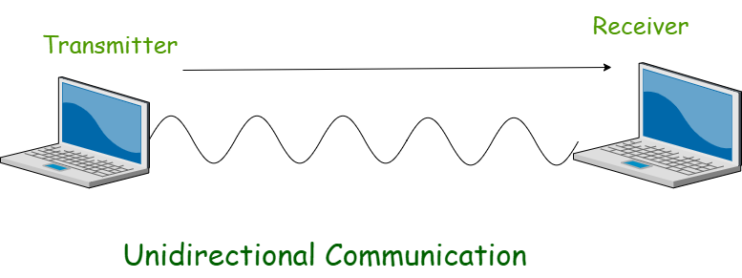
Wireless Communication Fundamentals: Basics of Wireless Communication:
Wireless communication takes places over free space through RF (radio frequency),
one device, a Transmitter, sends signal to another device, a Receiver.
Two devices (transmitter and receiver) must use same frequency (or channel) to be able to communicate with each other.
If a large number of wireless devices communicate at same time, radio frequency can cause interference with each other.
Interference increases as no of devices increases. .

Slide 29
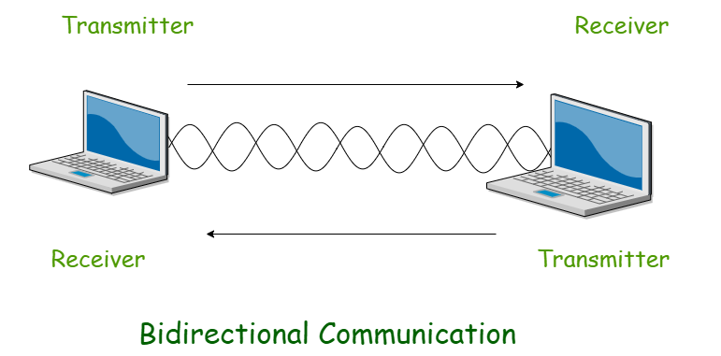
Wireless Communication Fundamentals: Basics of Wireless Communication:
Wireless communication is always half duplex as transmission uses same frequency or channel.
To achieve full duplex mode, devices use different frequency or channel of transmission and receiving of signals.

Slide 30
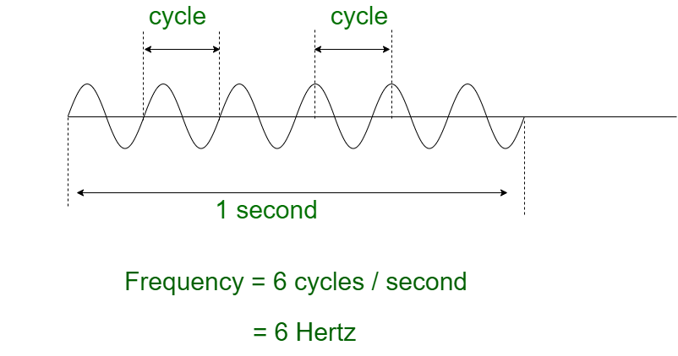
Wireless Communication Fundamentals: Basics of Wireless Communication:
Radio Frequency:
In free space, the sender (transmitter) sends an alternating current into a section of wire (an antenna).
This sets up a moving electric and magnetic fields that travel as travelling waves.
The electric and magnetic field moves along each other at a right angle to each other as shown.
The signal must keep changing or alternating by cycle up and down to keep electric and magnetic field cyclic and pushing forward.
The no of cycles a wave taking in a second is called Frequency of the wave.

Slide 31
Wireless Communication Fundamentals: Features of Wireless Communication:
The evolution of wireless technology has brought many advancements with its effective features.
The transmitted distance can be anywhere between a few meters (for example, a television's remote control) and thousands of kilometers (for example, radio communication).
Wireless communication can be used for cellular telephony, wireless access to the internet, wireless home networking, and so on.
Other examples of applications of radio wireless technology include GPS units, garage door openers, wireless computer mice, keyboards and headsets, headphones, radio receivers, satellite television, broadcast television and cordless telephones.

Slide 32
Wireless Communication Fundamentals: Wireless - Advantages:
Wireless communication involves transfer of information without any physical connection between two or more points.
Because of this absence of any 'physical infrastructure', wireless communication has certain advantages.
Cost effectiveness
Flexibility
Convenience
Speed
Accessibility
Constant connectivity

Slide 33
!!THANK YOU!! !! Have a Nice Day!!
Today we learned about
Wireless Communication Fundamentals: Overview of Wireless Communication Systems

